Slide 1
Instruction Set Architecture
Dionndra, Kenji, Nate, & Vincent

Slide 2

Hackers ( 1995 ) – A cheesy and now very dated film about teen-age hackers who uncover a corporate IT security engineer’s plot to embezzle millions from his firm. The film showcases Angelina Jolie and Matthew Lillard early in their careers.
Notes:
What says blossoming romance like a discussion of the merits of different Computer Architectures?

Slide 3
introduction

Slide 4
How do architectures differ?
Bits per instruction.
Operands per Instruction
Types of Instructions and Associated Operands
Operand Storage
Number of Explicit Operands per Instruction
Operand Location
Endianness
Notes:
16,32, and 64 bit per instruction are most common.
Operand storage is generally in stack, register or both.
Operand location is register to register, register to memory, memory to memory
My 15 years or so working in IT has shown IT folks to be as religious about technical differences as the Lilliputians about eggs, “Many hundred large Volumes have been published upon this Controversy: But the books of the Big-Endians have been long forbidden, and the whole Party rendered incapable by Law of holding Employments. During the Course of these Troubles, the Emperors of Blefuscu did frequently expostulate by their Ambassadors, accusing us of making a Schism in Religion, by offending against a fundamental Doctrine of our great Prophet Lustrog, in the fifty-fourth Chapter of the Brundrecal (which is their Alcoran.) This, however, is thought to be a meer Strain upon the Text: For the Words are these: That all true Believers shall break their Eggs at the convenient End: and which is the convenient End, seems, in my humble Opinion, to be left to every Man's Conscience, or at least in the power of the Chief Magistrate to determine. “
Don’t believe me find a baby boomer in IT with a long grey beard and ask him about vi vs emacs.

Slide 5
How are isas measured?
Amount of space a program requires
Complexity of Instruction Set
Length of Instructions
Total Number of Instructions
Notes:
Amount of space required depends on instruction size and whether or not instructions are variable in size.
Number of instructions in an ISA can range from 16 in Marie to 100’s on x86 and ARM.

Slide 6
ISA and internal storage in the CPU
Stack Architecture
Accumulator Architecture
General Purpose Register (GPR)
Notes:
Expanding on Operand Storage from a few slides ago. We have examples of all three CPU Storage.

Slide 7
Nate on MARIE

Slide 8
Bits per instruction. MARIE has 16 bits per instruction.
Operands per Instruction. MARIE instructions may have 0, 1, or 2 operands.
Types of Instructions and Associated Operands MARIE has 15 instructions of multiple types.
Operand Storage. MARIE stores its operands in registers.
Number of Explicit Operands per Instruction. MARIE may have up to one explicit Operand per instruction.
Operand Location. MARIE is register to register for its operand locations.
Notes:
4 bits for opcode and 12 for operands.
If two operands, one is implicit on the accumulator.
The accumulator is a register! (Register to register)

Slide 9
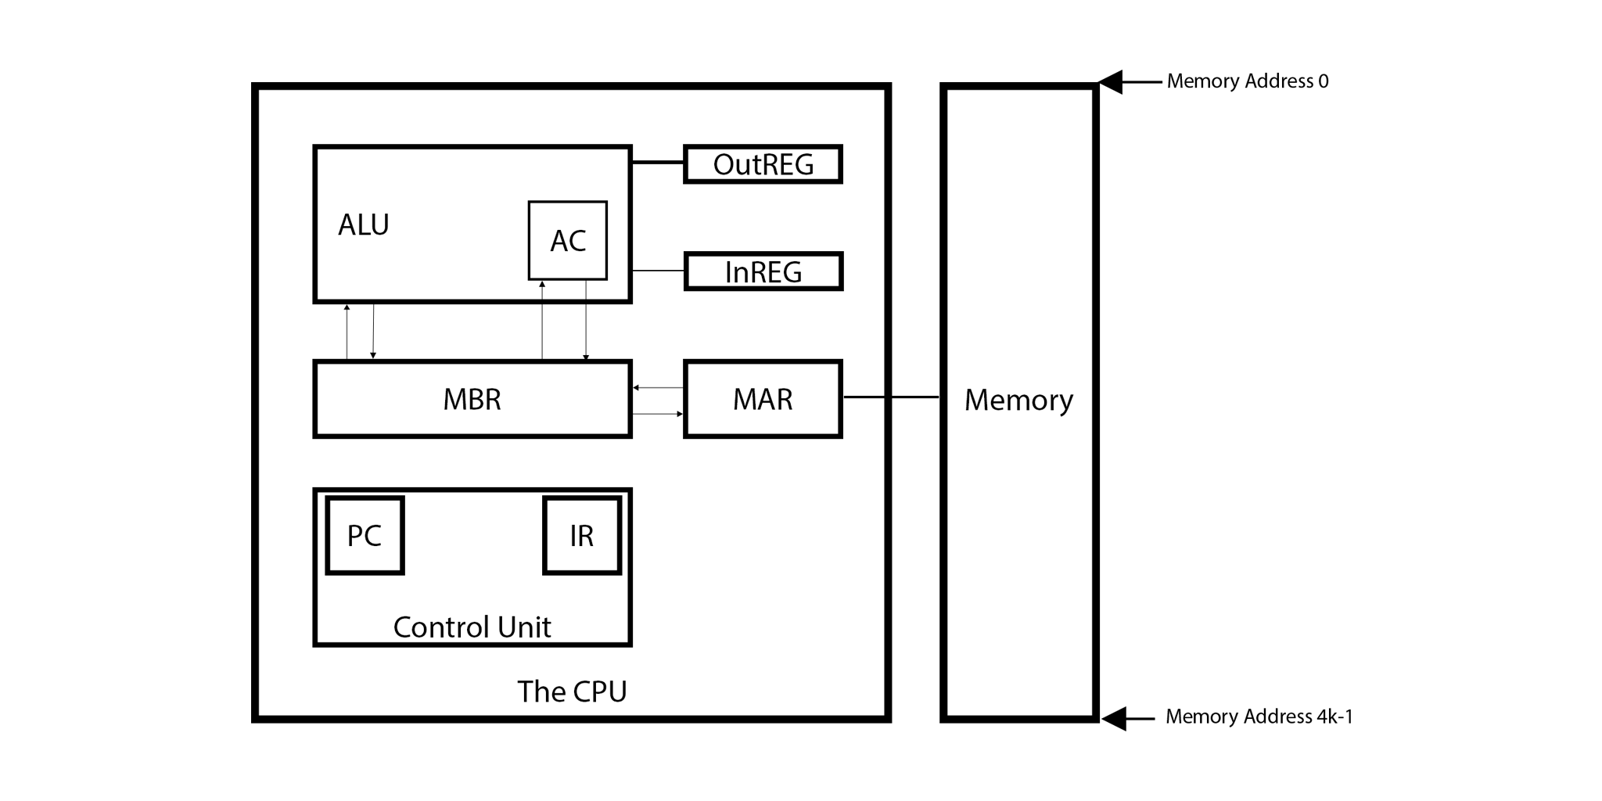
MARIE ARCHITECTURE

Slide 10
MARIE DATA MOVEMENT INSTRUCTION TYPES
Opcode | Instruction | Addressing Mode | Description
0001 | Load X | Direct | Load byte at X into AC
0010 | Store X | Direct | Store AC into memory at X
1101 | LoadI X | Indirect | Load byte referenced by pointer at X into AC
1110 | StoreI X | Indirect | Store AC at byte referenced by pointer at X
Notes:
There are different categories of instructions. I’ve broken up MARIE instructions to these categories.
Another difference in ISAs is how different instructions address memory, for example some of the MARIE Movement Instructions are direct (meaning the instruction includes an address that holds the explicit operand) and some are indirect ( meaning the instruction includes the address that holds a pointer to the operand ).

Slide 11
MARIE Arithmetic Operations
Opcode | Instruction | Addressing Mode | Description
0011 | Add X | Direct | Add value of byte at X to AC and store result in AC
0100 | Subt X | Direct | Subtract value of byte at X from AC and store result in AC
1011 | AddI X | Indirect | Add value of byte referenced by pointer at X to AC and store result in the AC
Notes:
Again, with the arithmetic operations we have a mix of direct and indirect memory access.

Slide 12
MARIE I/O Operations
Opcode | Instruction | Addressing Mode | Description
0101 | Input | Register Addressing | Load value from input register to AC
0110 | Output | Register Addressing | Load value from AC to output register
Notes:
Getting things in and out of the computer, so that its actually useful for humans!
I don’t believe that these neatly fit the Register Addressing category as they imply a single register rather than accepting one as an operand, but they are likely the best fit.

Slide 13
MARIE Transfer of Control operations
Opcode | Instruction | Addressing Mode | Description
0000 | JnS X (Jump and Store) | Indirect | “Cache” X in MAR, store current PC to X, and jump to X
1000 | Skipcond* | Register Addressing | Depending on highest 2 bits in operand portion of instruction, skip next instruction if AC is higher, equal to, or lower than zero.
1001 | Jump X | Direct | Load instruction at X into PC
1100 | JumpI X | Indirect | Load instruction referenced by pointer at X into PC
*Also a Boolean Logic instruction.
Notes:
Like input and output, doesn’t seem like Skipcond is a perfect fit.

Slide 14
MARIE special Purpose INstructions
Opcode | Instruction | Addressing Mode | Description
0111 | Halt | n/a | End the program.
1010 | Clear | Immediate | Set AC to zero.
Notes:
Clear is Marie’s only Immediate Addressing Mode instruction.

Slide 15
Dionndra on Intel

Slide 16
Cisc intel x86
Intel x86 was introduced in 1978 as the 8086 and was used in the IBM PC. It was the first 16 bit processor having 16 bit ALU, 16 bit registers, internal data bus, 16bit external data bus, which resulted in faster processing
It was split into two parts:
Execution unit
Bus interface unit: fetch instructions and addresses and communicates with the memory.
Since this they have modified and released multiple different versions of the 8086 to suit a lot of different needs.
Each member of the x86 family is known as complex instruction set computer or CISC. CISC machines have a larger number of instructions of variable length with complex layouts. They can perform multiple operations when a single instruction is executed.
Intel uses little endian, two address-architecture. They use register-memory architecture, which means that all instructions can operate on a memory location.

Slide 17
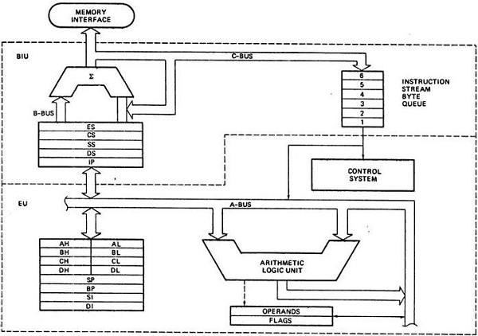

Slide 18
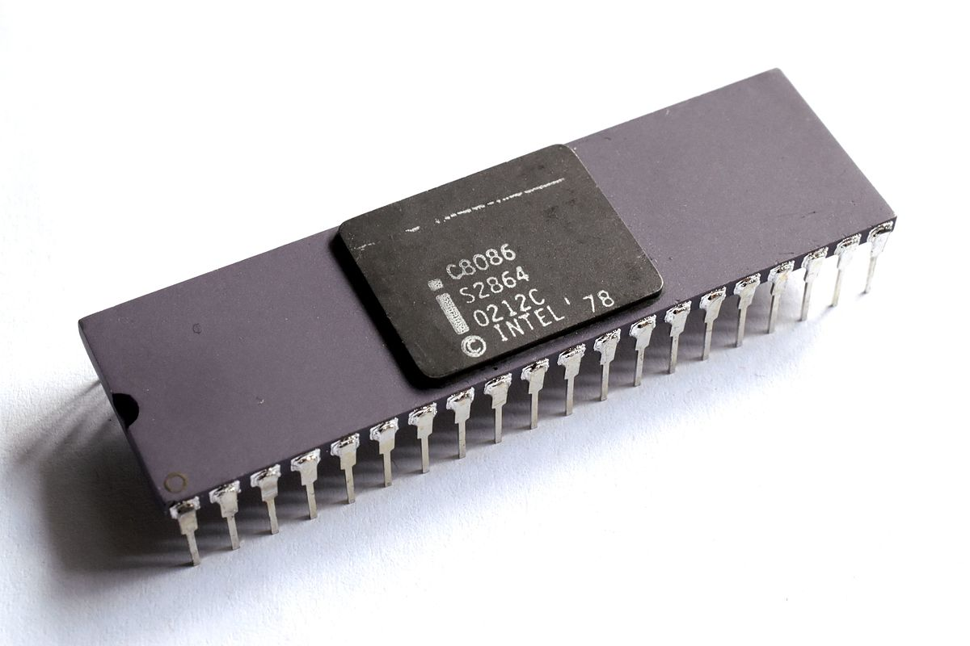
Intel x86 Processor

Slide 19
Instruction Set
The 8086 instruction set consists of these instructions:
Data Transfer Instructions: move, copy, load, exchange, push, pop, input and output
Arithmetic Instructions: add, subtract, increment, decrement, multiplication, convert, byte/word and compare
Logical Instructions: AND, OR, exclusive OR, NOT, shift/rotate and test
String Manipulation Instructions: load, store, move, compare and scan for byte/word
Control Transfer Instructions: conditional, unconditional, call subroutine and return from su subroutine
Input/output Instructions
Other instructions: setting/clearing flag bits, stack operations, software interrupts, etc.
Branch Instructions: used to call a procedure, jump, and return from a procedure
Flag manipulation instructions

Slide 20
Classification of Instructions
The Intel 8086s instructions are classified into different group based on the number of bytes in instruction are given. These groups are:
One-byte instructions
Two bytes instructions
Three and four-byte instructions
Five and six-byte instructions

Slide 21
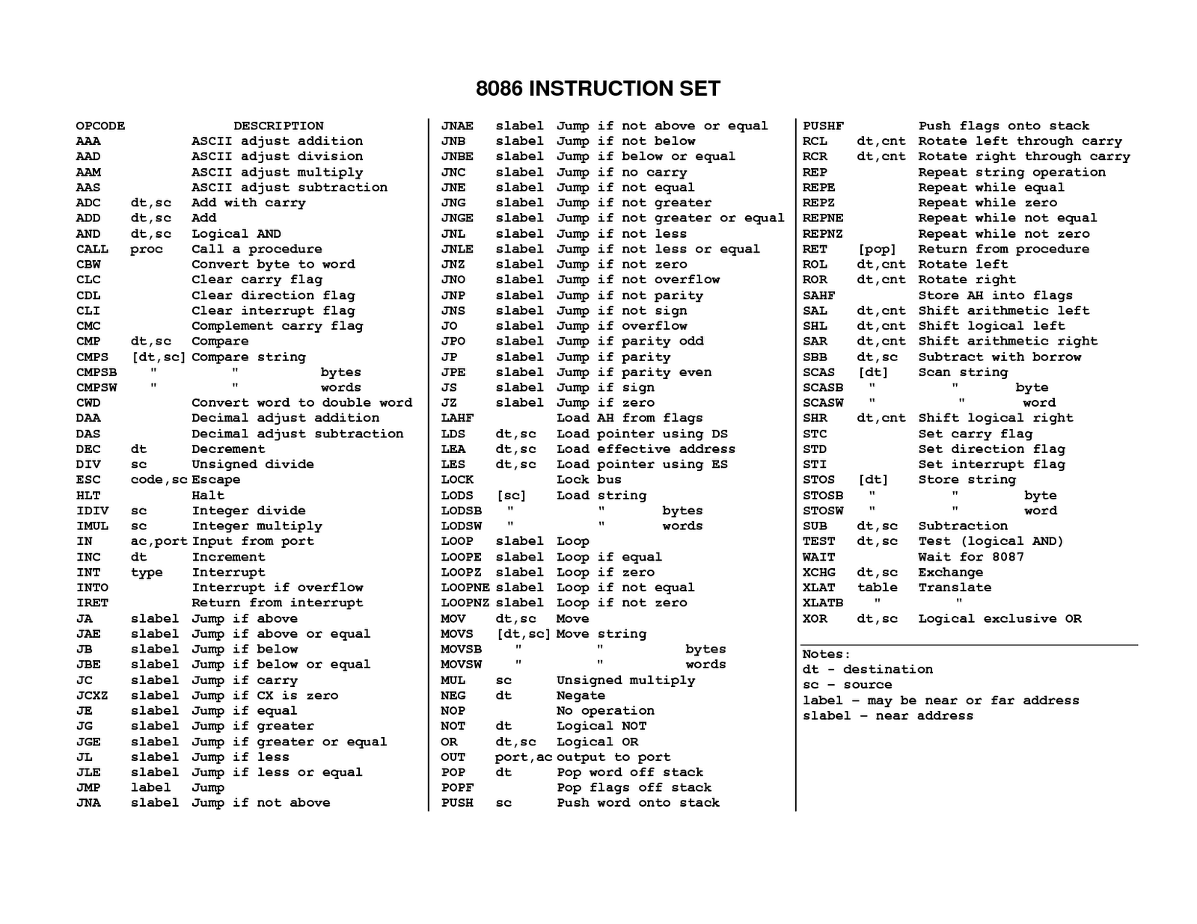

Slide 22
Intel x86 video
https://youtu.be/ZVnaklkMVt4

Slide 23
Vincent on arm

Slide 24
RISC ARM
- 32 bit instruction architecture
- ARM is a load/store architecture
* data processing must be performed in registers, not memory
- ARM uses fixed length, 3 operand instructions
- 37 total registers
- ARM useful for pipelining
* all ARM processors have at least a 3 stage pipeline. (fetch, decode, execute)

Slide 25
ARM Architecture Instruction Sets
ARM implements two different instruction sets
1.) 32 bit ARM instruction set
2.) 16 bit Thumb instruction set
- Thumb instruction set added to ARM to improve
code density. Reduces amount of storage space.
- Thumb instruction sets only have 8 registers available
instead of 16 registers

Slide 26
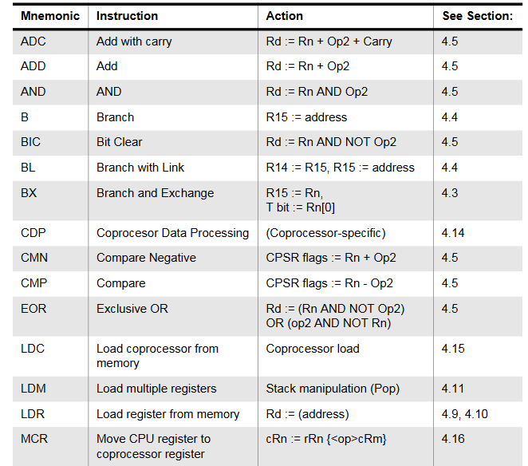
ARM Instructions

Slide 27
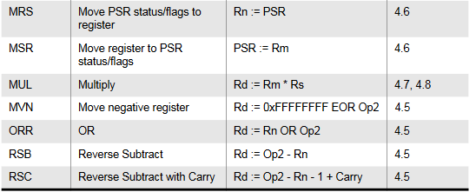
ARM Instructions

Slide 28
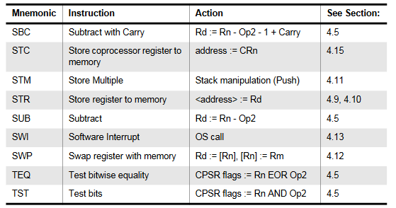
.
ARM Instructions

Slide 29
Kenji on the JVM

Slide 30
Java Virtual Machine (jvm)
How it Works
Notes:
Stack example

Slide 31
Java Virtual Machine (jvm)
Overview
How it Works
Notes:
Stack example

Slide 32
Java Virtual MAchine (jvm)
Overview
How it Works
Notes:
Stack example

Slide 33
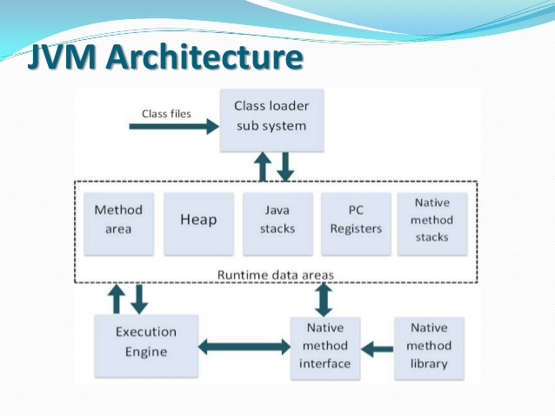
Overview
Software emulator, no physical hardware parts
Platform dependent
4 basic duties:
Analyzes bytecode from compiler
Interprets it into virtual machine code
Executes the code
Collects garbage
Stack
Notes:
The java virtual machine is a software emulator. And, as stated in its name, it is a virtual machine and has no physical hardware parts like other machines. Although java itself is platform independent, the java virtual machine is platform dependent, meaning it’s different in each operating system. The JVM has four basic duties. First it analyzes java bytecode sent from the compiler. Then, it converts that bytecode into virtual machine code. Next, it executes the code. Finally, it collects garbage from the heap to free up memory.

Slide 34

Stack
Implements Last In First Out order (LIFO)
Operands are on top of the stack
Access by push or pop from the stack
Notes:
Stack is a data structure that implements the Last in First out order, also known as LIFO. This means the operands are implicitly on top of the stack. Can access operands by pushing or popping onto the stack

Slide 35
ISA Type | Explicit operands per ALU instruction
Stack | 0 (operand implicit on stack)
Accumulator | 1
General-Purpose Register | 2,3
C = A + B
Stack | Accumulator | GPR
PUSH A | LOAD A | LOAD R1,A
PUSH B | ADD B | ADD R1,B
ADD | STORE C | STORE R1,C
POP C | - | -
Notes:
Compared to other ISA’s, since the operands of a stack are on top of the stack, we don’t need operands in ALU instruction like add or subtract. Whereas an accumulator like the MARIE sim, would need one operand, and a General Purpose Register would need 2 or 3 operands. Some advantages stack has over the two are Simple Model of expression evaluation, short instructions, and an ordered organization. However, compared to the others, it requires more instructions and that causes performance issues such as bottlenecking.

Slide 36
Stack
Implements Last In First Out order (LIFO)
Operands are on top of the stack
Access by push or pop from the stack
Notes:
Stack example

Slide 37
Overview
Software emulator, no physical hardware parts
Platform dependent
4 basic duties:
Analyzes bytecode from compiler
Interprets it into virtual machine code
Executes the code
Collects garbage
Stack
Notes:
Stack example

Slide 38
Java Virtual MAchine (jvm)
Overview
How it Works
Notes:
Stack example

Slide 39
Java Virtual MAchine (jvm)
How it Works
Notes:
Stack example

Slide 40
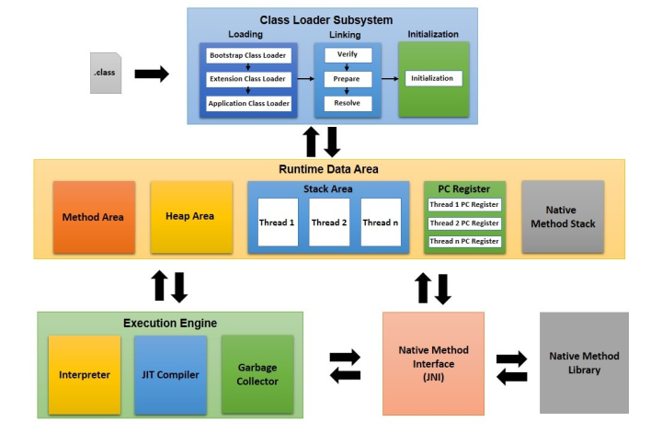
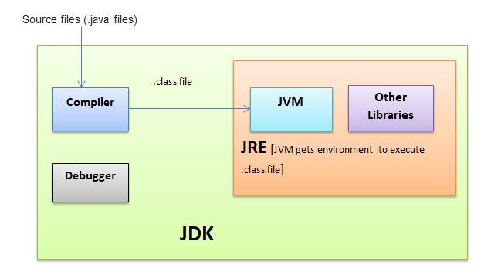
How It Works
Notes:
At the top you have the loading area that loads from the bootstrap classpath, classes inside the extension folder, and application level classpaths. Then it verifies the bytecode for properness, prepares memory for static variables, and resolves symbolic memory references with original memory references. And then initializing static variables blocks to their original values. Then in the runtime data area, you have the method area that holds everything in a class. The heap holds created objects so when your code instantiates an object it goes here. The stack is where the method area and heap come together to do work for each thread. The stack houses methods and their variables in their own frame. The PC registers holds the address to executing instructions for each thread. The interpreter interprets bytecode. The JIT compiler or just in time compiler helps speeds up the performance because the interpreter executes code slowly since it has to interpret every method even when it was already interpreted. JIT takes the bytecode and turn it into native code that doesn’t need to be interpreted every time. The garbage collector collects garbage from the heap, like unused objects, to free up memory. JNI and Native Method Libraries interact with each other and help execute native libraries.

Slide 41
Java Virtual MAchine (jvm)
How it Works
Notes:
Stack example

Slide 42
Summary
ISAs have various design differences including: Bits per instruction, Operands per Instruction, Types of Instructions and Associated Operands, Operand Storage, Number of Explicit Operands per Instruction, Operand Location, Endianness
ISAs are also measured various ways including: Amount of space a program requires, Complexity of Instruction Set, Length of Instructions, Total Number of Instructions
The 8086 paved the way for faster processors and for processors to implement complex instructions.
ARM architecture allows instruction level pipelining. This can speed up the fetch-code-execute cycle.
Java Virtual Machine(JVM) is a stack-type ISA
JVM makes Java platform independent but at the cost of performance

Slide 43
Sources
Null, L. & Lobur, J. ( 2019) The Essentials of Computer Organization and Architecture. Burlington, MA. Jones & Bartlett Learning.
Iain Softley (Producer & Director). (1995) Hackers [Motion Picture]. United States.
Swift, Jonathan, 1667-1745. (1950). Gulliver's travels. New York :Harper

Slide 44
Sources
Joseraj, Jackson. (2016) The JVM Architecture Explained, https://dzone.com/articles/jvm-architecture-explained
Koopman, Philip. Instruction Set Architecture (ISA), http://www.cs.kent.edu/~durand/CS0/Notes/Chapter05/isa.html
Classifying Instruction Set Architectures, http://cs.uccs.edu/~cs520/S99ch2.PDF
http://vision.gel.ulaval.ca/~jflalonde/cours/1001/h17/docs/arm-instructionset.pdf

